Slide 2
Learning is what most adults will do for a living in the 21st century.
(Lewis Perelman)
Do what you can, with what you have where you are.
(Theodore Roosevelt)
Teachers open the door, but you must enter by yourself.
(Chinese proverb)

Slide 3
The aims of the lesson:
To revise
To learn
To remember
Grammar
New words
The main characters

Slide 4
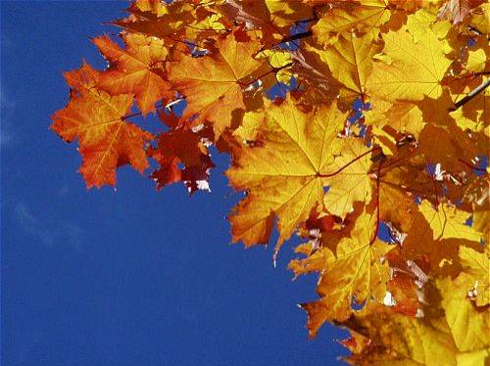
Leaves of Autumn

Slide 5
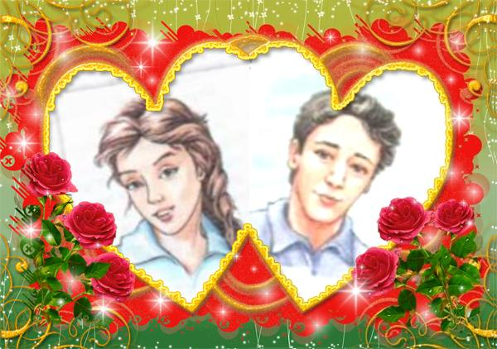
Lisa Korolyova
David Hunt
They met in Camp Pineland. They spent unforgettable summer days there. Now they came back to their homes. David devoted a beautiful song to Lisa. After listening to the song you’ll know if David feels happy or sad.

Slide 6
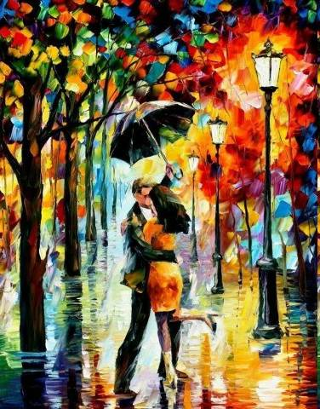
LOVE

Slide 7
PICTURE

Slide 8
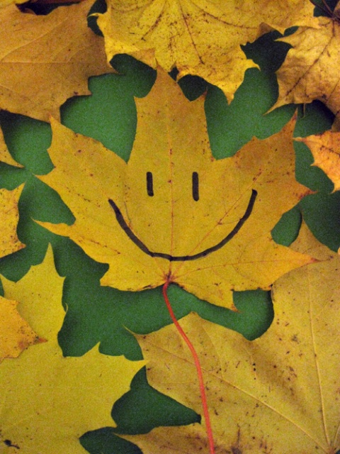
SMILE

Slide 9
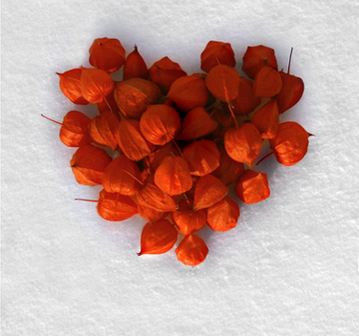
HEART

Slide 10
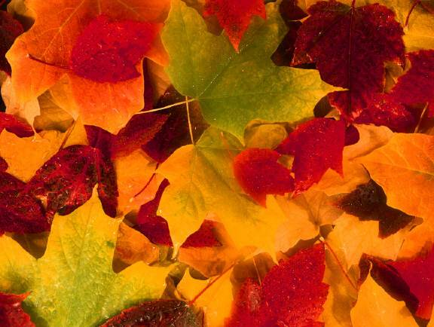
LEAVES OF AUTUMN

Slide 11
CONTINENTS

Slide 12
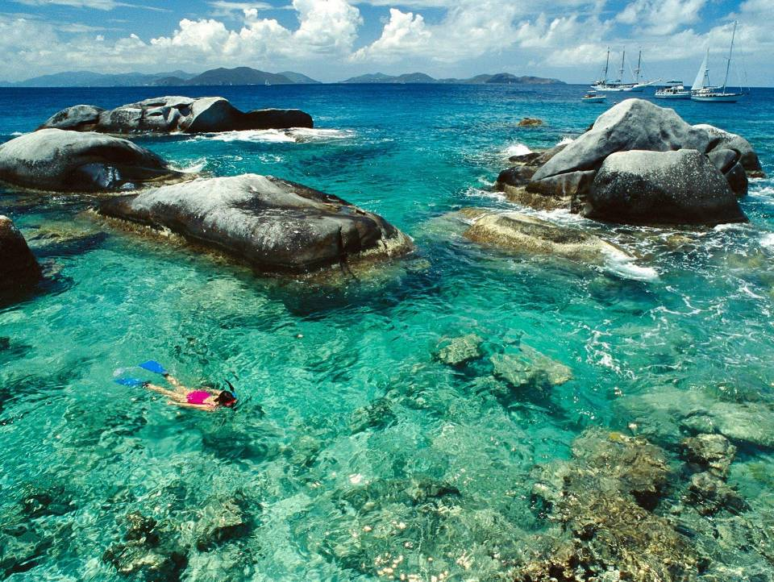
SEA

Slide 13
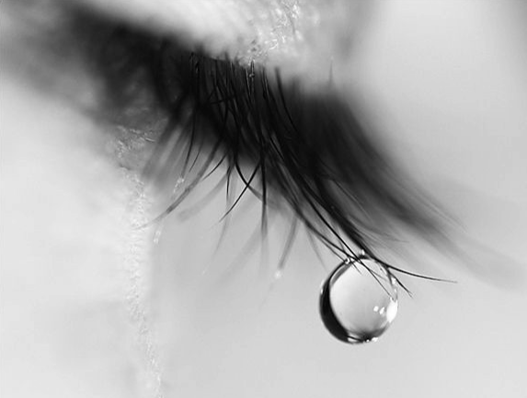
CRY

Slide 14
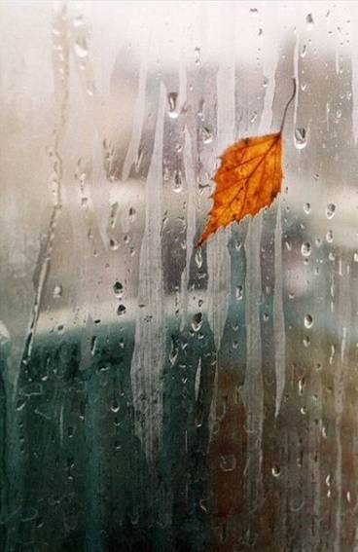
RAIN
RAIN
RAIN
RAIN
RAIN

Slide 15
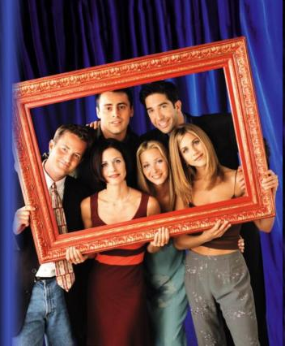
FRIENDS

Slide 16
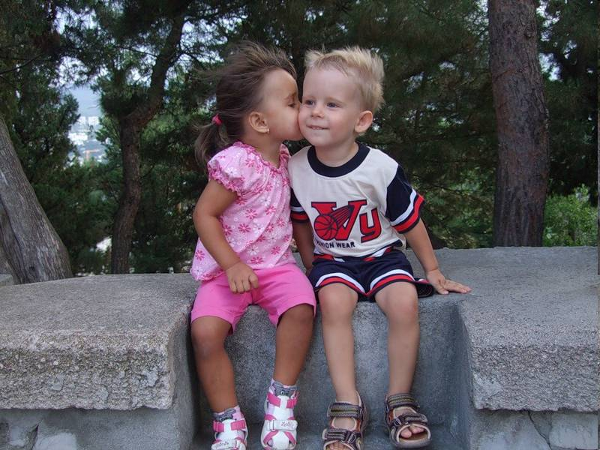
SECRETS

Slide 17
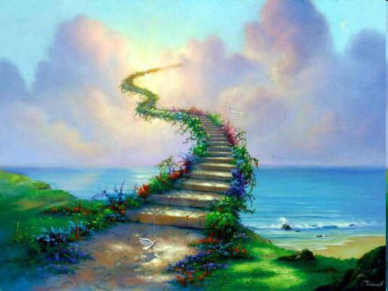
DREAMS

Slide 18
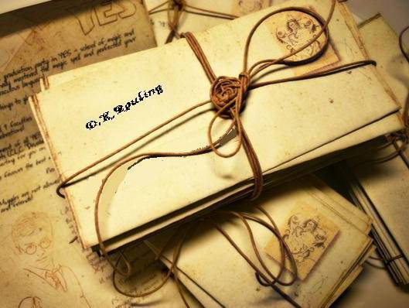
LETTERS

Slide 19
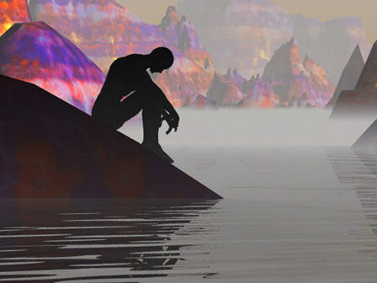
SORROWS

Slide 20
s
e
c
r
e
t
s
s
v
p
l
e
a
v
e
s
n
c
r
y
b
v
a
i
t
s
b
a
c
k
s
a
u
w
o
l
l
o
v
e
m
p
t
o
d
o
g
s
r
p
i
a
u
r
a
w
r
s
a
s
l
r
m
l
y
l
e
e
i
r
e
t
n
d
s
y
y
a
n
e
c
o
n
t
i
n
e
n
t
s
h
e
a
r
t
s
t
a
r
t

Slide 21
s
e
c
r
e
t
s
s
v
p
l
e
a
v
e
s
n
c
r
y
b
v
a
i
t
s
b
a
c
k
s
a
u
w
o
l
l
o
v
e
m
p
t
o
d
o
g
s
r
p
i
a
u
r
a
w
r
s
a
s
l
r
m
l
y
l
e
e
i
r
e
t
n
d
s
y
y
a
n
e
c
o
n
t
i
n
e
n
t
s
h
e
a
r
t
s
t
a
r
t

Slide 23
Ann: (you travel) Have you traveled a lot this summer?
Trish: Yes, I have. I have traveled all summer around Europe.
Ann: It’s cool! Who ______________ (1 you travel) with?
Trish: With my boyfriend Mark.
Ann: Wow? Where ______________ (2 you spend) June?
Trish: Mostly in Britain. But we've also travelled to Holland.
Ann : Great! ______________ (3 you see) many sights?
Trish: Yes, we (4) ______________ .
Ann: And how many countries ______________ (5 you visit)?
Trish: Just five.
Ann: Are you kidding? ______________ (6 you find) any friends?
Trish: No, I ______________ (7) But I’m not upset as (8 I get) the best friend.
Ann: Really? Who is it?
Trish: YOU, dear!

Slide 24
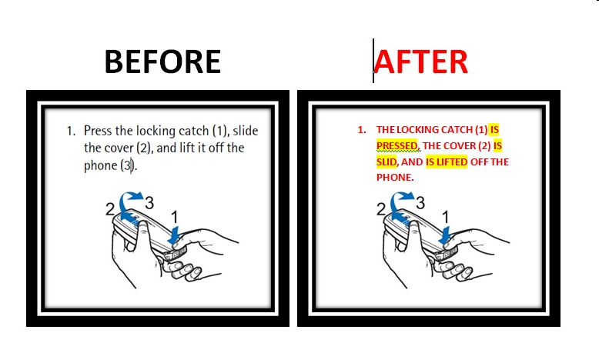
PRESENT PASSIVE VOICE

Slide 25
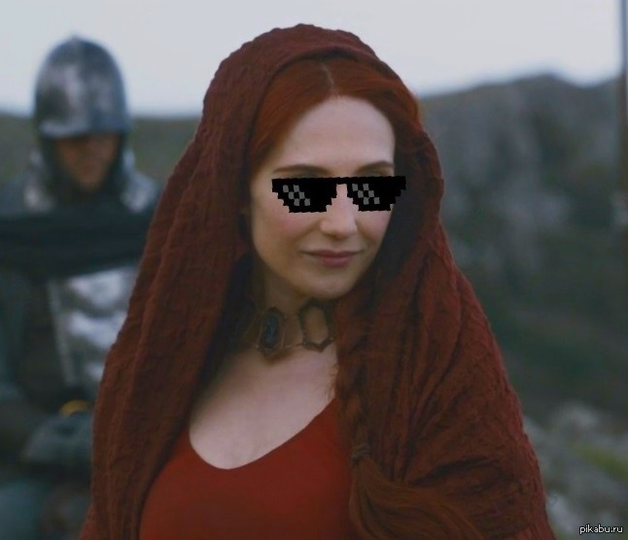
Home assignment:
Dialogue “What I have done by summer”
Learn the words
Revise The Present Perfect Tense
Additional task:
Translate the song

