Slide 1
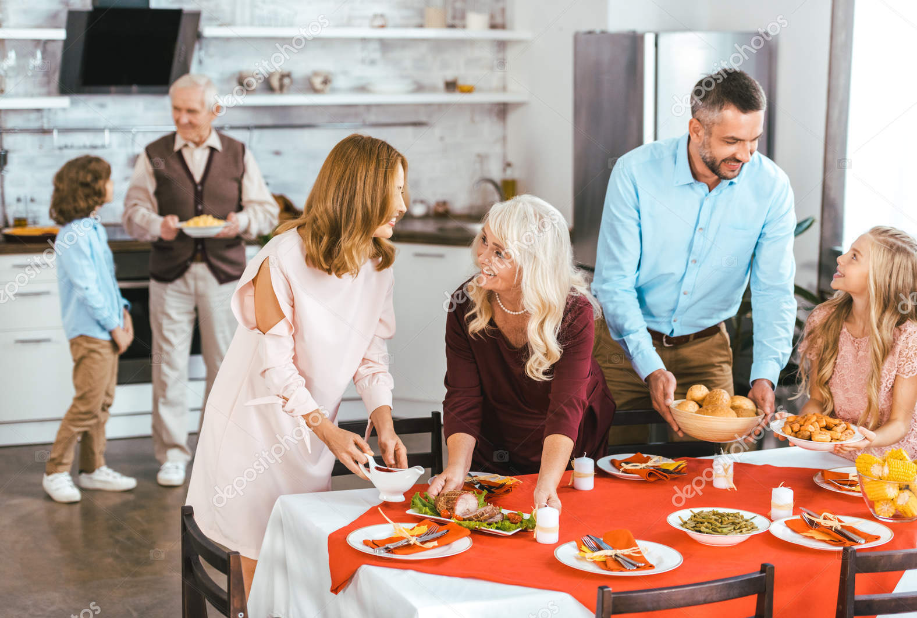
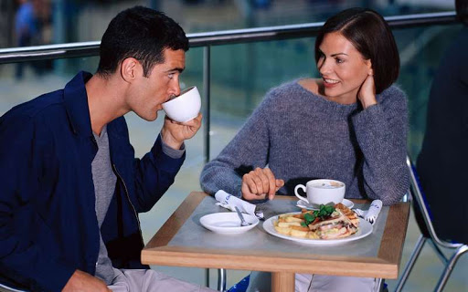
Day in, Day out

Slide 2
Use the model
I brush teeth in the morning and in the evening.
I play sports at weekends.

Slide 3
Do you know who this boy is?

Slide 4
Present Simple Tense
I / You/We/They + глагол
He/ She/It +глагол(e)s
I never wake up late.
He never wakes up late.
You always go to the theatre on Sunday.
She always goes to the theatre on Sundays.

Slide 5
Present Simple Tense
+ I go to school.
+ He goes to school.
- I don’t go to school.
- He doesn’t go to school.
? Do you go to school?
? Does he go to school?

Slide 6
How about…?

Slide 7
Do
don’t
Does
does
Do
don’t
Does
doesn’t
Do
don’t

Slide 8
I’m afraid
I don’t think so.
That’s a great
Count me in.
is not really my thing

Slide 9
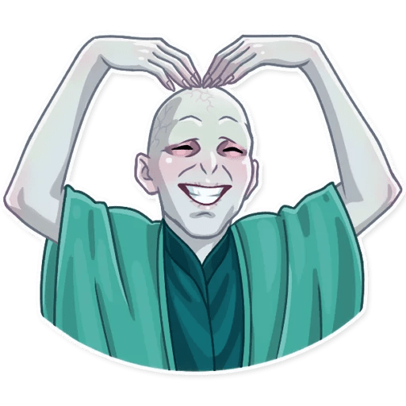
Home task
In pairs make up a dialogue. Use Ex. 6, p. 38-39 as a module.
Learn in by heart

Slide 10
My Perfect Day

Slide 11
works
takes
gets
cooks
listens
goes
watches
has
leaves
turns
catches
checks
drives
plays
relaxes
finishes
loves
likes
wakes
spends

Slide 13
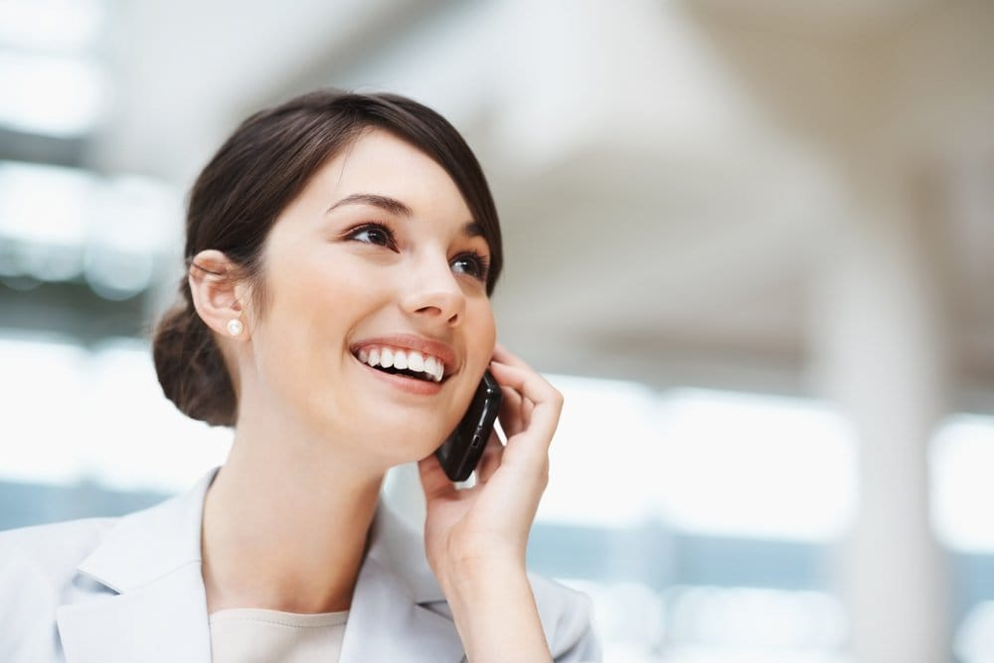
Making and cancelling an appointment

Slide 14
Making an appointment | Cancelling an appointment
Are you free tomorrow?
When would you like to meet?
I'm afraid I can't make it to the cinema tonight.
We'll do it some other time.
Shall we say 12:30 at the train station?
Sounds great!
How about Friday night then?

Slide 15
Reading rules
heat feet seek beat beef meat meet peace deep keep team meal | hit fit sick bit kit tip till pick gift pig film hip
[ ı: ]
[ ı ]

Slide 16
Home task
Ex. 4, p. 42 – Make up a dialogue in pairs, use Ex 3, p. 42 as a model. Choose a situation in Ex. 4.
Learn the dialogue by heart.

Slide 17
Progress Check

Slide 18
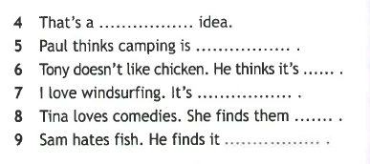
n
e
e
s
i
n
a
n
a
s
t
c
o
i
n
g
r
e
a
u
l
u
u
l
x
i
t
i
g
n
o
y
a
l
e
i
g
s
t
n
g

Slide 19
Match the colunms
Go out with
Listen to
Eat out
Put on
Put up
Set off
Arrive in
Get along with
Worry about
Pass along
Find out
Wake up
Argue with
Предоставлять, давать
Ругаться с к-л
Выходить на улицу (гулять)
Кушать не дома
Просыпаться
Надевать
Слушать
Переживать о ч-л
Отправляться в путь
Устанавливать
Выяснять
Ладить с к-л
Прибывать

Slide 20
go
have
do

Slide 21
Present Simple Tense
I / You/We/They + глагол
He/ She/It +глагол(e)s
I never wake up late.
He never wakes up late.
You always go to the theatre on Sunday.
She always goes to the theatre on Sundays.

Slide 22
Present Simple Tense
+ I go to school.
+ He goes to school.
- I don’t go to school.
- He doesn’t go to school.
? Do you go to school?
? Does he go to school?

Slide 23
spends
studies
walks
washes
tries
begins
does
tidies
plays
watches
flies

Slide 24
Do
don’t
Does
does
Do
don’t
Does
does
Do
do
Does
doesn’t
Does
doesn’t
Do
do

Slide 25
spends
go
doesn’t work
visits
does he do
works
doesn’t like
prefers

Slide 26
Rewrite these sentences to their question form
I always arrive at work early. – Do you always arrive at work early?
They usually eats breakfast. –
We often see Sarah. - …
Linda lives in London. - …
He often plays the piano. - …
Do they usually eat breakfast?
Do we often see Sarah?
Does Linda live in London?
Does he often play the piano?

Slide 27
Home task
Get ready for the test on Module 4

