Slide 1
Pirate's fruit salad

Slide 2
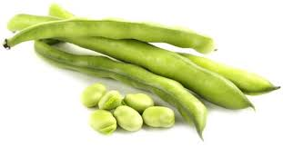
beans

Slide 3
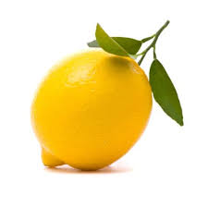
lemon

Slide 4
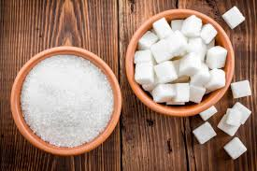
sugar

Slide 5
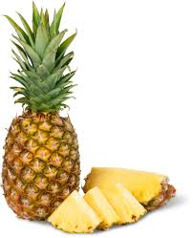
pineapple

Slide 6
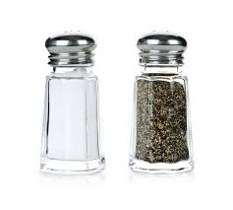
Salt and pepper

Slide 7
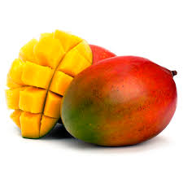
mango

Slide 8
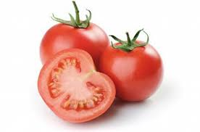
tomato

Slide 9
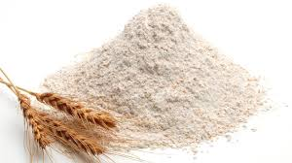
flour

Slide 10
Bread
Lemons
Water
Salt
Apples
Flour
Mangos
Pepper
Butter
Eggs
Boys
Sugar
Pineapples
Coffee
Tomatoes
Исчисляемые существительные | Неисчисляемые существительные

Slide 11
Fill in much or many
There isn’t ________ flour in the cupboard.
There aren’t_______ beans in the basket.
There isn’t _______ butter left.
There are ________ grapes on the plate.
There are ________ hamburgers on the plate.
There isn’t ________ jam on the bread.
There is ________ sugar in his tea.
There are ________ tomatoes in the basket.
much
many
much
many
many
much
much
many

Slide 12
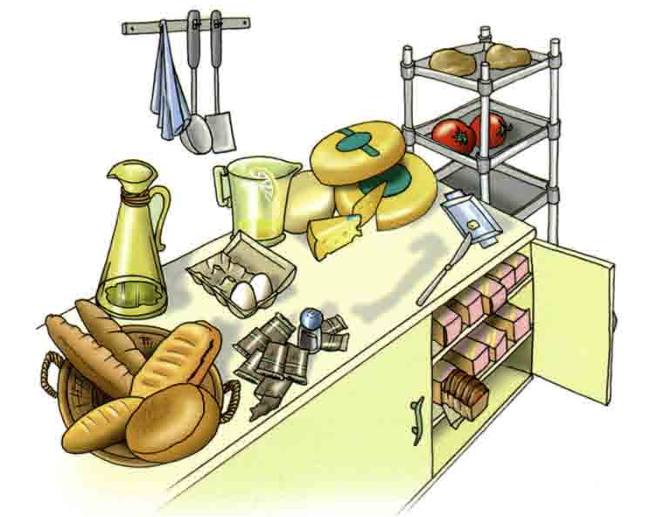
How many How much | cheese bread olive oil lemon juice eggs tomatoes potatoes butter biscuits pepper salt | are there? is there?
A lot./ Not many.
A lot./ Not much

Slide 13
Fill in some, any, how much, how many
any
Have we got ________ cheese?
Yes, we’ve got_________ cheese.
__________cheese have we got?
One slice.
We haven’t got __________ flour and there aren’t __________ tomatoes.
OK. We will get _________ flour and __________ tomatoes too.
What about pineapple? Are there __________ pineapples?
Yes, there are ___________ pineapples.
____________ pineapples have we got?
We’ve got three pineapples.
some
How much
any
any
some
some
any
some
How many

